Slide 1



PROGRESS REPORT
DISTRICT – NANDED
REGION
, 2023

Slide 2
District Overview
Taluka | Category | No. of Schemes | Work Order Issued | Work In Progress | Work Not Started
Ardhapur | Retro | 6 | 5 | 3 | 2
 | New | 2 | 2 | 2 | 0
Bhokar | Retro | 10 | 8 | 4 | 4
 | New | 1 | 1 | 0 | 1
Biloli | Retro | 6 | 6 | 3 | 3
 | New | 16 | 16 | 10 | 6
Degloor | Retro | 9 | 9 | 4 | 5
 | New | 0 | 0 | 0 | 0
Dharmabad | Retro | 16 | 16 | 5 | 11
 | New | 0 | 0 | 0 | 0
Hadgaon | Retro | 6 | 6 | 3 | 3
 | New | 12 | 12 | 7 | 5
Himayatnagar | Retro | 9 | 9 | 3 | 6
 | New | 9 | 9 | 3 | 6
Kandhar | Retro | 48 | 45 | 40 | 5
 | New | 10 | 9 | 8 | 1
Kinwat | Retro | 41 | 39 | 19 | 20
 | New | 39 | 37 | 16 | 21

Slide 3
District Overview
Taluka | Category | No. of Schemes | Work Order Issued | Work In Progress | Work Not Started
Loha | Retro | 23 | 19 | 16 | 3
 | New | 18 | 16 | 12 | 4
Mahur | Retro | 17 | 17 | 11 | 6
 | New | 26 | 22 | 10 | 12
Mudkhed | Retro | 5 | 5 | 1 | 4
 | New | 2 | 2 | 0 | 2
Mukhed | Retro | 64 | 60 | 26 | 34
 | New | 15 | 14 | 9 | 5
Naigaon | Retro | 11 | 10 | 7 | 3
 | New | 15 | 15 | 8 | 7
Nanded | Retro | 10 | 10 | 9 | 1
 | New | 5 | 5 | 3 | 2
Umri | Retro | 8 | 8 | 7 | 1
 | New | 8 | 8 | 4 | 4
Total | Retro | 289 | 272 | 161 | 111
 | New | 178 | 168 | 92 | 76
Grand Total |  | 467 | 440 | 253 | 187

Slide 4
Executive Summary Work in Progress Schemes
Taluka | Category | No. of Schemes | No. of Schemes based on Physical Progress %
 |  |  | < 25% | 25 < 50% | 50 < 75% | 75 < 100% | Commissioned
Ardhapur | Retro | 3 | 3 | 0 | 0 | 0 | 0
 | New | 2 | 2 | 0 | 0 | 0 | 0
Bhokar | Retro | 4 | 3 | 0 | 1 | 0 | 0
 | New | 0 | 0 | 0 | 0 | 0 | 0
Biloli | Retro | 3 | 2 | 1 | 0 | 0 | 0
 | New | 10 | 9 | 1 | 0 | 0 | 0
Degloor | Retro | 4 | 2 | 2 | 0 | 0 | 0
 | New | 0 | 0 | 0 | 0 | 0 | 0
Dharmabad | Retro | 5 | 1 | 4 | 0 | 0 | 0
 | New | 0 | 0 | 0 | 0 | 0 | 0
Hadgaon | Retro | 3 | 1 | 0 | 2 | 0 | 0
 | New | 7 | 6 | 1 | 0 | 0 | 0
Himayatnagar | Retro | 3 | 2 | 1 | 0 | 0 | 0
 | New | 3 | 2 | 1 | 0 | 0 | 0
Kandhar | Retro | 40 | 37 | 0 | 3 | 0 | 0
 | New | 8 | 6 | 2 | 0 | 0 | 0
Kinwat | Retro | 19 | 18 | 1 | 0 | 0 | 0
 | New | 16 | 15 | 0 | 1 | 0 | 0

Slide 5
Executive Summary Work in Progress Schemes
Taluka | Category | No. of Schemes | No. of Schemes based on Physical Progress %
 |  |  | < 25% | 25 < 50% | 50 < 75% | 75 < 100% | Commissioned
Loha | Retro | 16 | 12 | 3 | 1 | 0 | 0
 | New | 12 | 11 | 1 | 0 | 0 | 0
Mahur | Retro | 11 | 11 | 0 | 0 | 0 | 0
 | New | 10 | 7 | 3 | 0 | 0 | 0
Mudkhed | Retro | 1 | 0 | 0 | 1 | 0 | 0
 | New | 0 | 0 | 0 | 0 | 0 | 0
Mukhed | Retro | 26 | 25 | 1 | 0 | 0 | 0
 | New | 9 | 9 | 0 | 0 | 0 | 0
Naigaon | Retro | 7 | 6 | 1 | 0 | 0 | 0
 | New | 8 | 7 | 1 | 0 | 0 | 0
Nanded | Retro | 9 | 5 | 3 | 1 | 0 | 0
 | New | 3 | 1 | 1 | 1 | 0 | 0
Umri | Retro | 7 | 5 | 2 | 0 | 0 | 0
 | New | 4 | 3 | 0 | 0 | 1 | 0
Total | Retro | 161 | 133 | 19 | 9 | 0 | 0
 | New | 92 | 78 | 11 | 2 | 1 | 0
Grand Total |  | 253 | 211 | 30 | 11 | 1 | 0

Slide 6
Abstract of Schemes – Work in Progress Category – “Retro”
Sr No | Scheme Name | Name of Agency | W.O. Amount (excl GST) | W.O. Date | Construction Period | Physical Progress
Ardhapur Taluka
1 | Delub Bk | Sambhajirao Shelgaonkar | 54,50,764 | 12-10-2022 | 12 Months | 14.16%
2 | Pangri | Vinayak Panditrao Langde | 30,88,319 | 13-02-2023 | 6 Months | 10.15%
3 | Bamani | Mohammad Bilal | 29,76,070 | 31-01-2023 | 6 Months | 1.62%
Bhokar Taluka
4 | Dorli | Saikrupa Construction (P.P Parmeshwar Kishanrao Bhalerao) | 28,02,964 | 10-12-2022 | 6 Months | 50.63%
5 | Amthana | Vishal Construction (P.P Vaman Kashiram Rathod ) | 42,92,445 | 29-09-2022 | 6 Months | 24.50%
6 | Sayal | Shivkrupa Construction | 26,51,940 | 15-12-2022 | 6 Months | 8.13%
7 | Gargotwadi | Meera Construction | 39,14,375 | 19-12-2022 | 6 Months | 2.80%
Biloli Taluka
8 | Pachpimpali | Vishok Mahadu Chanchalwad | 71,35,008 | 31-01-2023 | 12 Months | 26.80%
9 | Bawalgaon | Maroti Shankar Chanchalwad | 37,61,679 | 31-10-2022 | 6 Months | 1.50%
10 | Kasrali | Anjivani Construction | 3,96,17,501 | 05-12-2022 | 24 Months | 0.19%

Slide 7
Abstract of Schemes – Work in Progress Category – “Retro”
Sr No | Scheme Name | Name of Agency | W.O. Amount (excl GST) | W.O. Date | Construction Period | Physical Progress
Degloor Taluka
11 | Mujlaga | Neha Madhavrao Methalwar | 1,43,97,493 | 12-01-2023 | 18 Months | 43.88%
12 | Hali | Kazi Earthmovers And Land Developers Pr. Ltd | 66,26,462 | 17-10-2022 | 12 Months | 36.09%
13 | Martoli | Kazi Earthmovers And Land Developers Pr. Ltd. | 1,27,73,773 | 17-10-2022 | 18 Months | 16.12%
14 | Mandgi | Deepak Devidas Matake | 81,30,015 | 15-12-2022 | 12 Months | 7.73%
Dharmabad Taluka
15 | Belgujari | M.S. Construction , (P.P.) Madhavrao Sambhaji Kadam | 64,34,607 | 12-08-2022 | 12 Months | 37.91%
16 | Illegaon Thadi | Kunal Constructions (P.P) Ramesh Madhavrao Patil | 31,38,456 | 01-09-2022 | 6 Months | 29.44%
17 | Pangari | M/S Shivaji Shinde | 32,64,628 | 05-09-2022 | 6 Months | 27.31%
18 | Chikana | Kunal Construction | 79,86,259 | 26-09-2022 | 12 Months | 25.71%
19 | Ilegaon | Best Enteprises | 65,63,123 | 31-10-2022 | 12 Months | 0.41%
Hadgaon Taluka
20 | Jambhal Sawali | Shri. Bapu Enterprises (P.P) Shridhar Bapurao Kadam | 23,71,955 | 08-08-2022 | 6 Months | 68.62%
21 | Morgavhan | Khandoba Construction | 14,03,297 | 23-12-2022 | 6 Months | 53.79%

Slide 8
Abstract of Schemes – Work in Progress Category – “Retro”
Sr No | Scheme Name | Name of Agency | W.O. Amount (excl GST) | W.O. Date | Construction Period | Physical Progress
22 | Kinala |  | 38,57,586 | 31-01-2023 | 6 Months | 1.95%
Himayatnagar Taluka
23 | Dabdari | Sudha Construction | 74,22,000 | 31-10-2022 | 12 Months | 42.64%
24 | Kautha & Wadi | Wasim Khan Jayi Khan | 59,35,057 | 12-09-2022 | 12 Months | 14.20%
25 | Moregaon | Vaibhav Balaji Lalame | 17,37,854 | 22-09-2022 | 6 Months | 8.43%
Kandhar Taluka
26 | Masalga | Eng.Vishal Sontakke | 53,88,000 | 13-10-2022 | 12 Months | 59.34%
27 | Gonar | Zahiroddin (P.P) Zahiroddin Azuruddin | 1,09,39,859 | 12-08-2022 | 18 Months | 52.13%
28 | Mangnali | Sudhir Jadhav | 1,24,95,135 | 12-10-2022 | 18 Months | 51.90%
29 | Bhendewadi | Latpate Construction |  |  | Months | 16.65%
30 | Rahati | Shivkumar Madhavrao Methalwad | 95,98,705 | 15-12-2022 | 12 Months | 15.52%
31 | Wanjarwadi | Maheshwari Construction | 58,90,732 | 22-08-2022 | 12 Months | 13.57%
32 | Navrangpura | M S Construction | 32,85,866 | 12-09-2022 | 6 Months | 12.90%
33 | Lath Kh | Sanjeevani Construction | 1,29,02,006 | 12-10-2022 | 18 Months | 11.53%
34 | Brahmanwadi | Patil Construction | 72,98,808 | 31-01-2023 | 12 Months | 11.39%

Slide 9
Abstract of Schemes – Work in Progress Category – “Retro”
Sr No | Scheme Name | Name of Agency | W.O. Amount (excl GST) | W.O. Date | Construction Period | Physical Progress
35 | Daithana | Patil Construction | 48,34,824 | 07-12-2022 | 6 Months | 8.92%
36 | Ghaghardarwadi | Sanjeevani Construction | 1,37,77,906 | 31-01-2023 | 18 Months | 8.44%
37 | Dahikalmba | Ramesh Madhavrao Patil | 1,38,02,011 | 26-09-2022 | 18 Months | 7.49%
38 | Shirshi | G.G. Humbad Patil | 1,15,19,269 | 06-01-2022 | 18 Months | 6.32%
39 | Pokharni | Maheshwari Construction | 1,00,43,955 | 31-10-2022 | 18 Months | 5.93%
40 | Narnali | Santosh K Ade | 1,01,44,650 | 28-10-2022 | 12 Months | 5.68%
41 | Hadoli | Maheshwari Construction | 85,01,248 | 31-10-2022 | 12 Months | 4.75%
42 | Kartala | Patil Construction | 1,13,98,884 | 23-01-2023 | 18 Months | 4.64%
43 | Harbal Pk | Sainath Jadhav Construction | 1,37,17,746 |  | 18 Months | 4.47%
44 | Guntur | Yash Construction | 1,68,18,488 | 30-01-2023 | 18 Months | 3.64%
45 | Somthana | Amol Construction | 70,32,947 | 07-12-2022 | 12 Months | 3.34%
46 | Shriganwadi | Basveshwar Construction | 38,21,241 | 31-12-2023 | 6 Months | 3.04%
47 | Gaul | Vishal Construction | 1,47,22,533 | 31-10-2022 | 18 Months | 2.57%
48 | Pimpalyachiwadi | Maheshwari Construction, (P.P) Narayanrao Khema Jadhav | 19,51,186 | 22-08-2022 | 6 Months | 2.13%

Slide 10
Abstract of Schemes – Work in Progress Category – “Retro”
Sr No | Scheme Name | Name of Agency | W.O. Amount (excl GST) | W.O. Date | Construction Period | Physical Progress
49 | Chikhalbhosi | Vasant Ganpatrao Kambale | 59,75,201 | 31-10-2022 | 12 Months | 2.01%
50 | Guttewadi | Ramkishan Patil Construction | 44,31,516 | 23-01-2023 | 6 Months | 1.69%
51 | Kalhali | Maheshwari Construction |  | 29-01-2023 | Months | 1.11%
52 | Patalganga | Santosh K. Aade | 34,30,078 | 31-01-2023 | 6 Months | 1.10%
53 | Bhojuchiwadi | Sai Construction | 98,37,500 | 30-12-2022 | 12 Months | 0.94%
54 | Warkhrad & Wadi | Nageshkumar Ishwarrao Latpate | 79,45,513 | 15-12-2022 | 12 Months | 0.93%
55 | Kotbzar | Adnan Rashed, (P.P) Mahomad Adnan Rashed | 65,35,923 | 12-08-2022 | 12 Months | 0.81%
56 | Bolka | Mahalaxmi Construction | 1,11,48,402 | 31-01-2023 | 18 Months | 0.60%
57 | Panshevadi | Deepak Chavhan | 1,64,29,741 | 16-01-2023 | 18 Months | 0.52%
58 | Ambulga | Pratibha Construction | 1,66,58,206 | 16-01-2023 | 18 Months | 0.46%
59 | Shekapur | Maheshwari Construction | 1,67,67,140 | 31-10-2022 | 24 Months | 0.44%
60 | Digras Kh | Mahaveer Gurunath Jadhav | 1,47,14,328 | 14-12-2022 | 18 Months | 0.34%
61 | Mahalingi | Shri Sai Construction | 95,16,336 | 07-12-2022 | 12 Months | 0.28%
62 | Ghodaj | Sayim Construction | 2,28,61,270 | 24-01-2023 | 24 Months | 0.27%

Slide 11
Abstract of Schemes – Work in Progress Category – “Retro”
Sr No | Scheme Name | Name of Agency | W.O. Amount (excl GST) | W.O. Date | Construction Period | Physical Progress
63 | Rui | Adnan Rashed | 2,86,44,984 | 30-12-2022 | 24 Months | 0.26%
64 | Bamani Pk | Sanjeevani Construction | 2,05,08,631 | 25-01-2023 | 24 Months | 0.21%
65 | Kalka | Ramesh Madhavrao Patil | 1,64,67,549 | 14-12-2022 | 18 Months | 0.11%
Kinwat Taluka
66 | Salaiguda | Narsinh Traders And Construction | 47,58,299 | 31-01-2023 | 6 Months | 30.70%
67 | Jarur Tanda | Pawar Construction | 71,00,208 | 31-01-2023 | 12 Months | 24.08%
68 | Bodhadi Kh | Gajanan P Munde | 1,58,08,701 | 22-08-2022 | 24 Months | 23.43%
69 | Malakjam 1 | Suryakant Lokhande | 72,60,111 | 31-01-2023 | 12 Months | 20.88%
70 | Pimpalgaon Sindkhed | J.R.Deshmukh | 1,04,73,695 | 30-01-2023 | 18 Months | 18.22%
71 | Pardi | Pandurang Construction | 95,22,454 | 09-02-2023 | 12 Months | 17.00%
72 | Kanki Tanda | Shri Datta Construction | 93,76,567 | 30-12-2022 | 12 Months | 14.65%
73 | Maregaon Khalche | Mirza Construction | 1,14,60,096 | 31-01-2023 | 18 Months | 13.96%
74 | Chikhali Tanda | Tamanna Infra Ventures | 63,64,944 | 01-01-2023 | 12 Months | 11.37%
75 | Navargaon | Shri Datta Construction | 57,67,171 | 14-12-2022 | 12 Months | 9.38%

Slide 12
Abstract of Schemes – Work in Progress Category – “Retro”
Sr No | Scheme Name | Name of Agency | W.O. Amount (excl GST) | W.O. Date | Construction Period | Physical Progress
76 | Shirpur |  | 82,82,081 | 16-01-2023 | 12 Months | 7.69%
77 | Dhanora Tanda | Mauli Construction | 56,16,081 | 27-01-2023 | 12 Months | 5.72%
78 | Paroti | Bhumi Construction | 50,98,160 | 15-02-2023 | 6 Months | 1.85%
79 | Ganeshpur Navi Wasti | P.P.Devidas Jalba Gite | 44,31,081 | 30-12-2022 | 6 Months | 1.45%
80 | Chikhali | Raghendra Construction | 56,78,617 | 14-12-2022 | 12 Months | 0.87%
81 | Andbori | Ashishkumar Ramakanrao Deshmukh | 66,30,334 | 31-10-2022 | 12 Months | 0.85%
82 | Nandgaon | Gajanan P Mundhe | 77,06,304 | 31-12-2022 | 12 Months | 0.71%
83 | Chandrapur Navi Wasti | Shivprasad Construction | 62,82,839 | 09-02-2023 | 12 Months | 0.66%
84 | Malakjam Tanda | Narayan Ramrao Tamanna | 1,07,96,359 | 14-12-2022 | 18 Months | 0.47%
Loha Taluka
85 | Nila | Sohel Construction And Steel Work (P.P.) Shiakh Nazir Ahemad | 1,00,41,815 | 17-08-2022 | 18 Months | 56.75%
86 | Wadgaon | Sudha Construction | 91,30,672 | 31-10-2022 | 18 Months | 44.93%
87 | Mangrul | Amol Dnyaneshwar Hake | 66,63,741 | 15-12-2022 | 12 Months | 37.91%
88 | Gundewadi | M S Construction | 77,56,562 | 31-10-2022 | 12 Months | 32.55%

Slide 13
Abstract of Schemes – Work in Progress Category – “Retro”
Sr No | Scheme Name | Name of Agency | W.O. Amount (excl GST) | W.O. Date | Construction Period | Physical Progress
89 | Dhanora Shelgaon | Bhumi Construction | 45,41,813 | 14-10-2022 | 6 Months | 24.49%
90 | Golegaon Pk | Sanjeevani Construction | 1,29,85,252 | 05-02-2022 | 18 Months | 15.75%
91 | Hatani | G G Humbad Patil | 99,15,624 | 28-10-2022 | 12 Months | 8.04%
92 | Pimpalgaon Ayub & Hottalwadi | Sudhir Narayan Deshmukh | 81,10,907 | 15-12-2022 | 12 Months | 7.55%
93 | Anteshwar | Swapnil Deepak Manjaramkar |  | 12-08-2022 | 6 Months | 4.27%
94 | Pardi | Sudhir Jadhav | 1,67,75,490 | 31-10-2022 | 24 Months | 1.04%
95 | Zari | Munde Gajanan Prabhakar | 75,70,952 | 31-10-2022 | 12 Months | 0.86%
96 | Kanjala & Wadi | Omkar Construction | 1,28,75,202 | 14-12-2022 | 18 Months | 0.72%
97 | Ashtur | Sanjeevani Construction | 2,13,63,343 | 30-12-2022 | 24 Months | 0.36%
98 | Malegaon | Avinash Uddavrao Suryawanshi | 2,51,47,718 | 08-12-2022 | 24 Months | 0.29%
99 | Wadepuri | Dipak Vitthalrao Chavan | 3,38,26,593 | 16-01-2023 | 24 Months | 0.18%
100 | Hipparga Chitali | M S Construction | 85,51,160 | 31-10-2022 | 12 Months | 0.10%
Mahur Taluka
101 | Hadsani | Swapnil Deepak Manjaramkar | 1,30,76,514 | 15-12-2022 | 18 Months | 13.43%

Slide 14
Abstract of Schemes – Work in Progress Category – “Retro”
Sr No | Scheme Name | Name of Agency | W.O. Amount (excl GST) | W.O. Date | Construction Period | Physical Progress
102 | Murali & Nakhegaon | Vinod Narayan Pulte | 68,24,058 | 08-12-2022 | 12 Months | 6.02%
103 | Umra & Tanda | Govind Kishanrao Daregaonkar | 52,72,157 | 11-11-2022 | 12 Months | 4.55%
104 | Karanji C | Munde Dynanoba |  | 15-02-2023 | 12 Months | 3.27%
105 | Kerole | Shri Sai Construction | 34,23,808 | 14-12-2022 | 6 Months | 1.23%
106 | Gondgaon | Sanjivani Construction | 67,18,108 | 31-01-2023 | 12 Months | 0.97%
107 | Sawarkhed | Bhumi Construction | 52,42,632 | 30-12-2022 | 12 Months | 0.79%
108 | Digadi Bk | Raghvendra Construction | 74,94,889 | 15-12-2022 | 12 Months | 0.51%
109 | Ashta | Tushar Fabric | 16,27,790 | 15-02-2023 | 18 Months | 0.38%
110 | Lakhmapur | Anil Wathore Construction | 2,24,02,051 | 25-01-2023 | 24 Months | 0.36%
111 | Madnapur | Shobha Construction | 2,93,37,759 | 31-01-2023 | 24 Months | 0.26%
Mudkhed Taluka
112 | Pardi Vaijapur | Bhumi Construction, (P.P.) Janardhan Sahebrao Ambure | 44,84,657 | 26-09-2022 | 6 Months | 70.70%
Mukhed Taluka
113 | Bhaswadi | Datta Sahebrao Udbuke | 72,56,736 | 12-08-2022 | 12 Months | 39.22%

Slide 15
Abstract of Schemes – Work in Progress Category – “Retro”
Sr No | Scheme Name | Name of Agency | W.O. Amount (excl GST) | W.O. Date | Construction Period | Physical Progress
114 | Nandgaon Pk | Amol Construction | 90,20,320 | 15-12-2022 | 12 Months | 21.55%
115 | Tandali | Saim Construction | 1,13,34,568 | 30-10-2022 | 18 Months | 17.54%
116 | Chivli | Kunal Construction( P.P Ramesh Madhavrao Patil) | 59,82,271 | 26-09-2022 | 6 Months | 15.45%
117 | Adlur | Sayyad Moinuddin Kajari | 70,17,368 | 12-01-2023 | 12 Months | 12.98%
118 | Kerur | Venkatrao Uttamrao Mund | 1,59,31,551 | 22-08-2022 | 24 Months | 12.19%
119 | Thotwadi | Datta Sahebrao Udbuke | 78,66,961 | 12-08-2022 | 12 Months | 11.04%
120 | Salgara Bk. | Kazi Earthmovers & Land Devlepoers | 84,99,778 | 12-09-2022 | 12 Months | 9.51%
121 | Kharab Khandgaon | Raghvendra Construction | 1,34,63,312 | 15-12-2022 | 18 Months | 7.73%
122 | Chondi | Eng. Swapnil Patil | 1,17,48,897 | 12-09-2022 | 18 Months | 6.65%
123 | Gonegaon | Shaikh Ahemed Bashir | 89,59,600 | 14-12-2022 | 12 Months | 5.12%
124 | Bhatapur | Sohel Construction | 62,73,884 | 02-12-2022 | 12 Months | 4.47%
125 | Tupdal Kh. & Bk. | Zaheeroddin Construction | 1,44,01,746 | 15-12-2022 | 18 Months | 3.33%
126 | Undri | Ragvendra Construction | 2,21,85,372 | 11-01-2023 | 24 Months | 2.35%
127 | Sangavi Benak | Maroti Chanchalwad | 1,66,23,722 | 22-08-2022 | 24 Months | 1.76%

Slide 16
Abstract of Schemes – Work in Progress Category – “Retro”
Sr No | Scheme Name | Name of Agency | W.O. Amount (excl GST) | W.O. Date | Construction Period | Physical Progress
128 | Hippalnari | Gajanan Amratrao Patil | 54,32,032 | 22-08-2022 | 12 Months | 1.62%
129 | Rajura Tanda | Shivprasad Construction | 79,10,506 | 30-12-2022 | 12 Months | 0.61%
130 | Khatgaon Pd | Kunal Construction | 63,94,285 | 26-09-2022 | 12 Months | 0.57%
131 | Bamani | Gajanan A Patil | 1,25,91,918 | 22-08-2022 | 18 Months | 0.48%
132 | Manjari | Saim Construction | 1,56,51,219 | 28-10-2022 | 24 Months | 0.44%
133 | Jahur | Sudha Construction | 1,63,72,677 | 31-10-2022 | 24 Months | 0.44%
134 | Rajura Kh. & Rajura Thana | Sohail Construction | 85,01,118 | 13-12-2022 | 12 Months | 0.41%
135 | Kabnur | Sohail Construction | 1,60,53,535 | 12-12-2022 | 18 Months | 0.34%
136 | Saknur | Raghvendra Construction | 2,51,81,811 | 11-01-2023 | 24 Months | 0.31%
137 | Aandegaon | Ullas Bhausingh Chavhan | 1,04,14,717 | 27-01-2023 | 18 Months | 0.27%
138 | Wandgir | Amol Construction | 1,21,39,130 | 15-12-2022 | 18 Months | 0.17%
Naigaon Taluka
139 | Takali Tm | Jay Laxmi Construction | 1,03,37,762 | 14-12-2022 | 18 Months | 33.75%
140 | Wazirgaon | Lakshmi Narsinha Construction | 84,67,278 | 22-09-2022 | 12 Months | 20.22%

Slide 17
Abstract of Schemes – Work in Progress Category – “Retro”
Sr No | Scheme Name | Name of Agency | W.O. Amount (excl GST) | W.O. Date | Construction Period | Physical Progress
141 | Awrala | Ramkishan Patil Construction, (P. P.) Datta Kishanrao Kausalye | 42,35,586 | 12-08-2022 | 6 Months | 14.53%
142 | Kuntur | Kazi Earth Movers | 3,19,84,700 | 15-12-2022 | 24 Months | 9.80%
143 | Antargaon | Sahebrao Karlekar | 98,86,629 | 22-09-2022 | 12 Months | 8.75%
144 | Khandgaon | Raghvendra Construction, (P.P.) Rajkumar Tanaji Shriramwar | 50,16,790 | 12-08-2022 | 12 Months | 1.36%
145 | Takli Tb | Aditya Construction | 32,95,809 | 12-08-2022 | 6 Months | 1.07%
Nanded Taluka
146 | Jaitapur | Munde Gajanan Prabhakarrao (P.P Munde Gajanan Prabhakarrao ) | 56,10,508 | 22-08-2022 | 12 Months | 61.98%
147 | Dhanegaon | Sudha & Sahyog Construction | 4,23,54,958 | 09-12-2022 | 24 Months | 42.84%
148 | Visnupuri | Pratibha Construction | 3,64,29,000 | 08-08-2022 | 24 Months | 41.12%
149 | Dhanora Malku | Santosh Sambhajirao Shelgaonkar | 68,13,891 | 28-10-2022 | 12 Months | 40.16%
150 | Khadkut | Raghvendra Construction | 1,29,90,716 | 31-10-2022 | 18 Months | 20.73%
151 | Wadgaon | Priyanka Uttamrao Jadhav | 79,58,639 | 30-12-2022 | 12 Months | 13.69%
152 | Chimegaon | Pawade Construction (P.P Madhav Ganeshrao Pawade) | 61,13,054 | 20-10-2022 | 12 Months | 8.17%
153 | Sayal | Pavde Construction | 75,81,805 | 15-08-2022 | 12 Months | 1.00%

Slide 18
Abstract of Schemes – Work in Progress Category – “Retro”
Sr No | Scheme Name | Name of Agency | W.O. Amount (excl GST) | W.O. Date | Construction Period | Physical Progress
154 | Kotitirth | Shubham S Sangnale ( P.P Sangmale Shubham Shivajirao) | 61,96,046 | 01-09-2022 | 12 Months | 0.12%
Umri Taluka
155 | Mokhandi | Sohail Cinstruction And Steel Work (P.P Shaik Nazir Ahemad ) | 50,45,723 | 12-08-2022 | 12 Months | 31.76%
156 | Gortha & Anandibai Nagar | Sahyog Construction | 1,48,66,253 | 12-10-2022 | 18 Months | 25.92%
157 | Hangirga | Patil Construction | 55,50,945 | 14-12-2022 | 12 Months | 23.51%
158 | Bitnal | Prathmesh Santosh Pawade | 1,09,58,550 | 31-10-2022 | 18 Months | 11.09%
159 | Sindhi & Tanda | Sahayog Construction | 1,30,72,036 | 12-10-2022 | 18 Months | 11.05%
160 | Bothi | Shivam Raju Kendre | 48,96,450 | 05-09-2022 | 6 Months | 10.32%
161 | Shirur | Patil Construction | 1,24,98,909 | 31-10-2022 | 18 Months | 6.90%

Slide 19
Abstract of Schemes – Work in Progress Category – “New”
Sr No | Scheme Name | Name of Agency | W.O. Amount (excl GST) | W.O. Date | Construction Period | Physical Progress
Ardhapur Taluka
1 | Jambhrun | G R Deshmukh | 27,53,999 | 31-01-2023 | 6 Months | 1.94%
2 | Yelegaon | Vinayak Panditrao Langde | 87,43,328 | 31-01-2023 | 12 Months | 1.20%
Biloli Taluka
3 | Rampurthadi | Rajeshri Ramrao Abadalwar | 83,49,749 | 15-12-2022 | 12 Months | 36.38%
4 | Dugaon | Virbhadra Construction | 1,13,80,236 | 31-10-2022 | 18 Months | 22.23%
5 | Daulatapur | M.R. Construction | 29,48,992 | 15-12-2022 | 6 Months | 20.95%
6 | Ramtirth | Shobha Construction | 1,64,52,000 | 31-10-2023 | 24 Months | 19.35%
7 | Aalandi | Kailas Laxman Ubale | 1,05,76,915 | 22-08-2022 | 18 Months | 0.98%
8 | Rudrapur | Gajanan P Mundhe | 49,94,169 | 18-01-2022 | 6 Months | 0.64%
9 | Shimpala | Vikas Bhimrao Khandekar | 53,11,000 | 31-10-2022 | 12 Months | 0.59%
10 | Babhali | Pratibha Construction | 77,53,000 | 31-10-2022 | 12 Months | 0.58%
11 | Thadi Sawali | Riyaz Ansari Mo. Ekbal | 65,95,073 | 30-12-2022 | 12 Months | 0.54%
12 | Pimpalgaon Ku | G R Sanap Construction | 1,99,44,139 | 15-02-2023 | 18 Months | 0.37%

Slide 20
Abstract of Schemes – Work in Progress Category – “New”
Sr No | Scheme Name | Name of Agency | W.O. Amount (excl GST) | W.O. Date | Construction Period | Physical Progress
Hadgaon Taluka
13 | Choramba Kh | Santosh Sambhajirao Shelgaonkar | 51,31,446 | 01-09-2022 | 12 Months | 35.53%
14 | Kawtha | D.M. Murkute | 57,71,296 | 31-01-2023 | 12 Months | 10.22%
15 | Chendkapur |  | 42,33,841 | 16-01-2023 | 6 Months | 8.83%
16 | Gojegaon Belgvhan |  |  |  | Months | 4.53%
17 | Takalgaon |  | 41,49,251 | 31-01-2023 | 6 Months | 2.54%
18 | Ada-Dhanora |  | 58,83,056 | 16-01-2023 | 12 Months | 0.53%
19 | Talyachiwadi |  |  | 01-01-2023 | Months | 0.41%
Himayatnagar Taluka
20 | Kiramgaon | Bhagwati Construction | 48,30,304 | 31-10-2022 | 6 Months | 38.16%
21 | Wai Tanda | D M Murkute | 79,37,795 | 31-01-2023 | 12 Months | 1.65%
22 | Khaigaon Ta | Pralhad Ade |  | 31-01-2023 | Months | 0.12%
Kandhar Taluka
23 | Panbhosi | Kazi Earth Movers | 1,29,43,172 | 12-09-2022 | 18 Months | 37.17%

Slide 21
Abstract of Schemes – Work in Progress Category – “New”
Sr No | Scheme Name | Name of Agency | W.O. Amount (excl GST) | W.O. Date | Construction Period | Physical Progress
24 | Khudyachiwadi | Vaibhav Lalme | 53,94,969 | 12-09-2022 | 12 Months | 27.04%
25 | Mohija | Mohammad Adnan Rashed | 1,04,21,446 | 30-12-2022 | 18 Months | 9.16%
26 | Dharmapuri Majare | Shivkumar Madhavrao Methalwad | 61,81,280 | 15-12-2022 | 12 Months | 4.90%
27 | Shirur | Sushmita P Surywanshi | 1,21,21,000 | 31-10-2022 | 18 Months | 4.37%
28 | Marshivni | Sudhir Jadhav | 1,40,18,511 | 30-12-2022 | 18 Months | 3.94%
29 | Hanmantwadi | Arjun Sanjay More | 60,08,608 | 15-12-2022 | 12 Months | 1.64%
30 | Balanthwadi | Mahaveer Gurunath Jadhav | 83,57,463 | 13-12-2022 | 12 Months | 0.89%
Kinwat Taluka
31 | Pandhara | Mundhe Gajanan Prabhakarrao | 72,00,680 | 30-12-2022 | 12 Months | 51.59%
32 | Budhwarpeth | Sai Sun Power Agency | 15,85,005 | 31-01-2023 | 6 Months | 17.71%
33 | Sakru Naik Tanda | Raghvendra Construction | 64,74,604 | 14-12-2022 | 12 Months | 16.76%
34 | Talhari Tanda | Shri Datt Construction | 59,99,027 | 15-12-2022 | 12 Months | 16.19%
35 | Chinchkhed | Rajkumar Tanaji Shriramwar | 67,79,278 | 14-12-2022 | 12 Months | 14.20%
36 | Apprao Peth | Pratibha Construction | 1,41,98,173 | 31-10-2022 | 24 Months | 12.18%

Slide 22
Abstract of Schemes – Work in Progress Category – “New”
Sr No | Scheme Name | Name of Agency | W.O. Amount (excl GST) | W.O. Date | Construction Period | Physical Progress
37 | Karanji E | Prashant Gangadhar Ingale | 50,87,625 | 06-12-2022 | 6 Months | 9.34%
38 | Ritha Tanda | Raghvendra Construction | 30,10,865 | 31-01-2023 | 6 Months | 2.66%
39 | Phulenagar | Raghvendra Construction | 64,37,608 | 14-12-2022 | 12 Months | 1.27%
40 | Shingarwadi | Rajkumar Tanaji Shriramwar | 62,19,350 | 14-12-2022 | 12 Months | 1.14%
41 | Injegaon | Mundhe Gajanana | 60,12,291 | 30-12-2022 | 12 Months | 0.92%
42 | Kancheli | Shri Datt Construction | 70,45,494 | 31-01-2023 | 12 Months | 0.88%
43 | Lalunaik Tanda | Shri Sai Construction | 33,37,794 | 06-12-2022 | 6 Months | 0.87%
44 | Jaldhara Tanda | Ashishkumar Ramakantrao Deshmukh | 61,81,318 | 25-10-2022 | 12 Months | 0.63%
45 | Ghoti | Sohail Construction & Steel Work | 1,67,49,241 | 28-12-2022 | 24 Months | 0.48%
46 | Totamba | Prashant Gangadhar Ingle | 76,15,283 | 14-12-2022 | 12 Months | 0.20%
Loha Taluka
47 | Jomegaon | Bejgamwar Sanket Sunil | 93,26,324 | 31-10-2022 | 12 Months | 27.95%
48 | Londe Sanghvi | Kunal Construction | 1,20,87,056 | 14-12-2022 | 18 Months | 24.97%
49 | Sonmanjari | Eng.Avinash Uddhavrao Suryawanshi | 90,94,864 | 16-01-2023 | 12 Months | 22.60%

Slide 23
Abstract of Schemes – Work in Progress Category – “New”
Sr No | Scheme Name | Name of Agency | W.O. Amount (excl GST) | W.O. Date | Construction Period | Physical Progress
50 | Adgaon | Sandeep Construction | 1,28,14,008 | 21-11-2022 | 18 Months | 21.34%
51 | Dagadsangvi | Sandeep Construction | 1,15,44,091 | 21-11-2022 | 18 Months | 19.58%
52 | Joshi Sangavi | Maheshwari Construction | 1,35,52,815 | 17-08-2022 | 18 Months | 12.74%
53 | Devla Tanda | Maheshwaro Construction & Mahalaxmi Infra Corp | 1,39,59,990 | 08-12-2022 | 18 Months | 11.47%
54 | Chitali | Avinash Uddavrao Suryawanshi | 85,73,459 | 31-10-2022 | 12 Months | 9.84%
55 | Jawala | Pandurang Construction | 1,49,26,401 | 21-11-2022 | 18 Months | 4.49%
56 | Malkapur | Shri Sai Construction | 22,54,029 | 23-02-2023 | 6 Months | 1.40%
57 | Bhendegaon | G R Deshmukh | 93,42,630 | 30-12-2022 | 12 Months | 0.76%
58 | Sugaon | Sohel Construction & Steel Works | 63,50,000 | 05-12-2022 | 12 Months | 0.40%
Mahur Taluka
59 | Waifani | Shree Datta Construction | 38,09,509 | 20-10-2022 | 6 Months | 42.79%
60 | Mendaki | Shri Datta Construction | 31,35,423 | 14-11-2022 | 6 Months | 26.29%
61 | Satiguda | Alka Construction | 64,20,529 | 14-12-2022 | 12 Months | 25.25%
62 | Rampur Navi Wasti | Shobha Construction | 1,08,12,107 | 30-12-2022 | 18 Months | 9.57%

Slide 24
Abstract of Schemes – Work in Progress Category – “New”
Sr No | Scheme Name | Name of Agency | W.O. Amount (excl GST) | W.O. Date | Construction Period | Physical Progress
63 | Iwleshwar | Sohel Construction | 86,63,190 | 31-10-2022 | 12 Months | 8.30%
64 | Sindhkhed | Shri Datta Construction | 1,06,43,265 | 30-01-2023 | 18 Months | 1.30%
65 | Banjara Tanda | Raghvendra Construction | 1,19,81,377 | 14-12-2022 | 18 Months | 1.12%
66 | Anmal | Virbhadra Construction | 99,57,328 | 31-10-2022 | 18 Months | 0.74%
67 | Pachunda | Shobha Construction | 1,22,45,603 | 31-10-2022 | 18 Months | 0.54%
68 | Wanola | Sohel Construction And Steel Works | 1,34,90,869 | 08-12-2022 | 18 Months | 0.50%
Mukhed Taluka
69 | Khairka & Khairkawadi | Amol Construction | 1,16,72,207 | 15-12-2022 | 18 Months | 9.11%
70 | Hipparga De | Vishal Digambarrao Sontakke | 1,05,87,045 | 17-10-2022 | 18 Months | 8.20%
71 | Mandlapur | Dnyaneshwar Ramekar | 1,13,94,255 | 31-10-2022 | 18 Months | 7.83%
72 | Bennal | Vivek Hanmantrao Surnar | 99,66,322 | 14-12-2022 | 18 Months | 3.12%
73 | Borgaon | Shivprasad Construction | 69,95,145 | 20-01-2022 | 12 Months | 1.04%
74 | Kolgaon | Abhijeet Tate | 55,55,727 | 31-01-2023 | 12 Months | 0.77%
75 | Wadgaon | Saim Construction | 1,20,94,552 | 22-08-2022 | 18 Months | 0.62%

Slide 25
Abstract of Schemes – Work in Progress Category – “New”
Sr No | Scheme Name | Name of Agency | W.O. Amount (excl GST) | W.O. Date | Construction Period | Physical Progress
76 | Berli Bk | Susmita P Suryawanshi | 1,31,87,537 | 12-08-2022 | 18 Months | 0.61%
77 | Eklara | Shobha Construction | 3,92,57,364 | 31-01-2023 | 24 Months | 0.16%
Naigaon Taluka
78 | Navandi | Kazi Earth Movers & Land Developers | 76,99,680 | 17-10-2022 | 6 Months | 32.12%
79 | Mokasdara | Kazi Earthmovers | 69,05,813 | 12-09-2022 | 12 Months | 17.85%
80 | Kopara | Bhumi Construction | 38,63,642 | 30-12-2022 | 6 Months | 13.21%
81 | Mandani | Pratap Vainkatrao Gavhane | 64,92,389 | 17-01-2023 | 12 Months | 11.20%
82 | Rui Kh | Jaylakshmi Construction (Pr. Vipil Vikas Patil ) | 86,37,087 | 31-10-2022 | 12 Months | 9.05%
83 | Salegaon | Shobha Construction | 1,21,29,359 | 28-10-2022 | 18 Months | 0.57%
84 | Kuncholi | Bejgamwar Sanket Sunil | 1,44,83,399 | 31-10-2022 | 18 Months | 0.51%
85 | Rui Bk | Pratibha Construction | 1,13,13,484 | 13-12-2022 | 18 Months | 0.07%
Nanded Taluka
86 | Dhoki | Santosh Sambhaji Shelgaonkar | 75,74,600 | 01-09-2022 | 12 Months | 57.58%
87 | Pimpalgaon Mistri | Pandurang Construction | 83,49,292 | 09-02-2023 | 12 Months | 25.61%

Slide 26
Abstract of Schemes – Work in Progress Category – “New”
Sr No | Scheme Name | Name of Agency | W.O. Amount (excl GST) | W.O. Date | Construction Period | Physical Progress
88 | Rahati Bk | Sahebrao Karlekar | 1,08,93,740 | 14-12-2022 | 18 Months | 5.29%
Umri Taluka
89 | Bijegaon | Pawade Construction(P.P Madhav Ganeshrao Pawade) | 39,44,320 | 17-08-2022 | 6 Months | 80.70%
90 | Bolsa | Pranav Prahlad Aade | 1,10,45,681 | 28-10-2022 | 12 Months | 18.17%
91 | Jirona | Saeem Construction | 56,72,292 | 31-10-2022 | 12 Months | 7.14%
92 | Kalgaon | Ramakant Dattopant Rapatwar | 1,37,79,718 | 16-01-2023 | 18 Months | 3.15%

Slide 27
Dashboard

Slide 28
Dashboard
Work Status

Slide 29
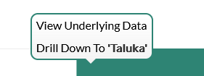
Dashboard
Progress Milestone

Slide 30
Dashboard
Work Status – “New” Schemes
Work Status – “Retro” Schemes

Slide 31
MS Project
Work in Progress Schemes

Slide 32
Sample Site Visit Photos

Slide 33
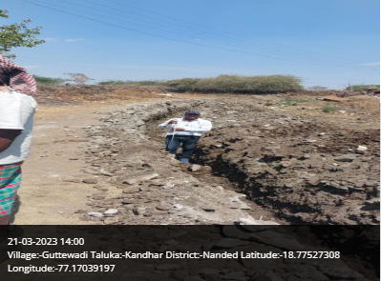
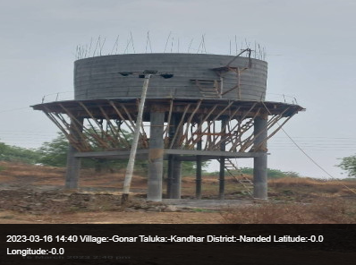
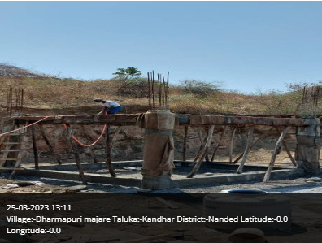
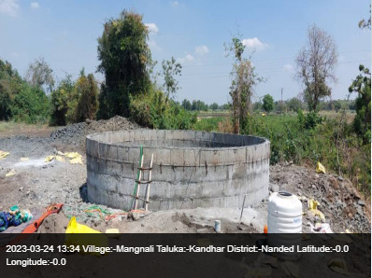
Kandhar Taluka

Slide 34
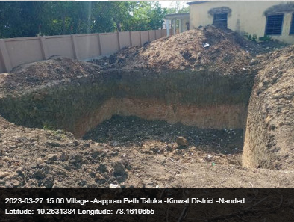
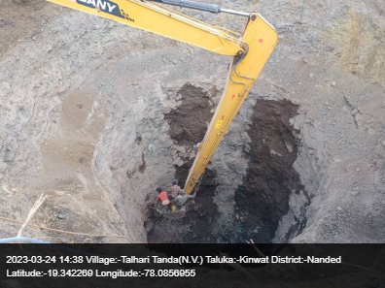
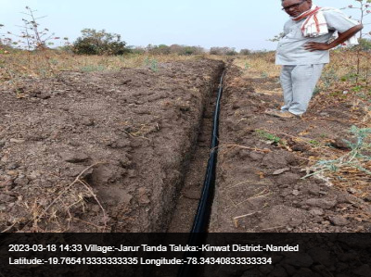
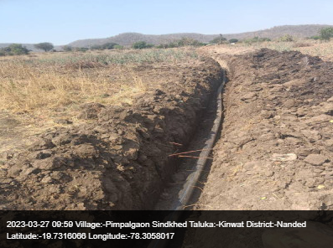
Kinwat Taluka

Slide 35
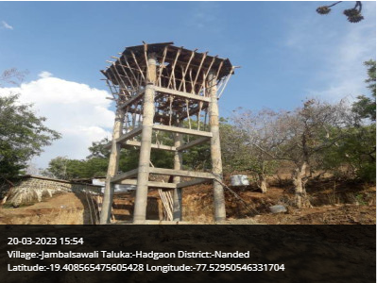
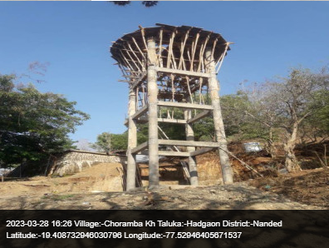
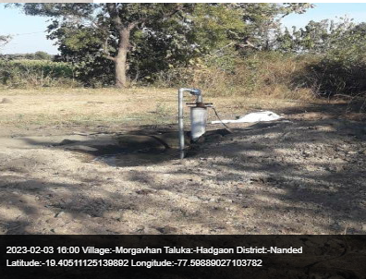
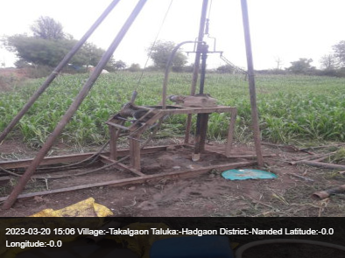
Hadgaon Taluka

Slide 36
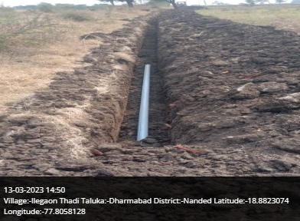
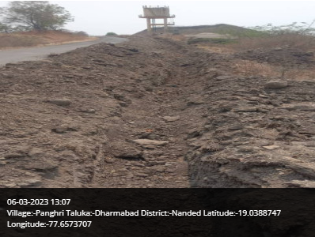
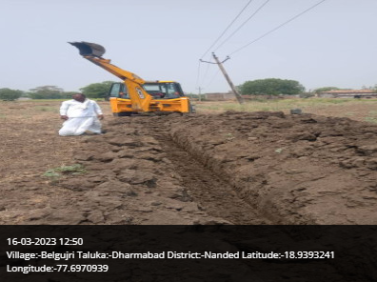
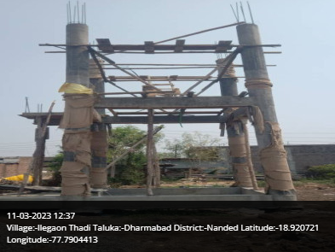
Dharmabad Taluka

Slide 37
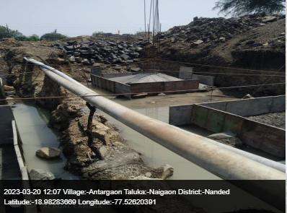
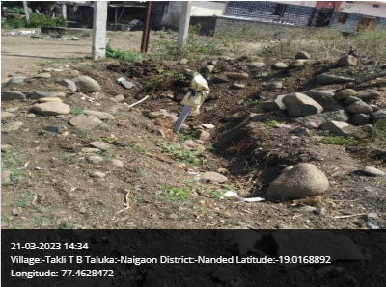
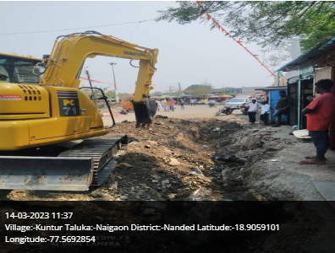
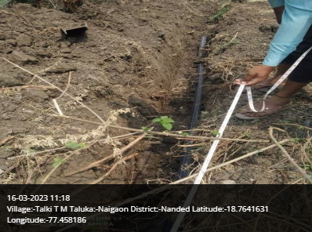
Naigaon Taluka

Slide 38
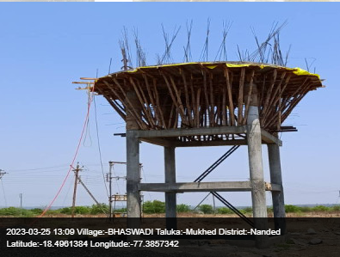
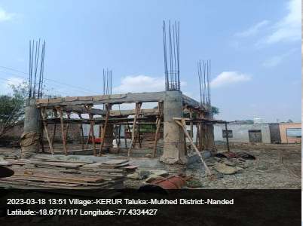
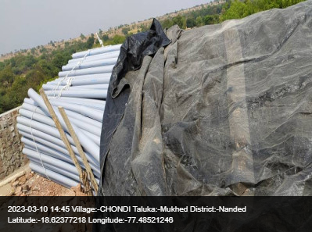
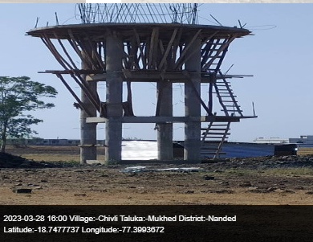
Mukhed Taluka

Slide 39
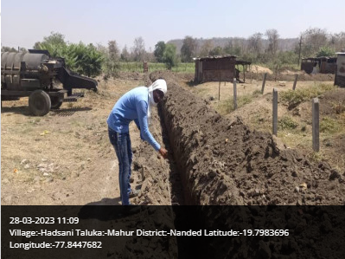
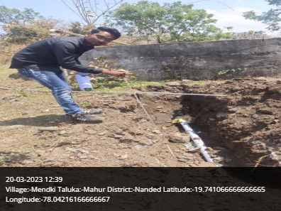
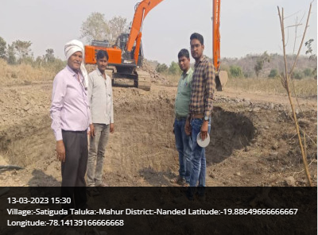
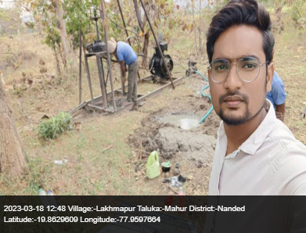
Mahur Taluka

Slide 40
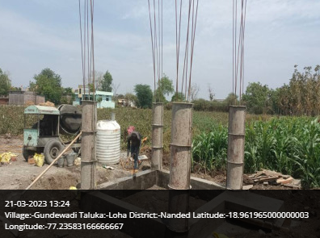
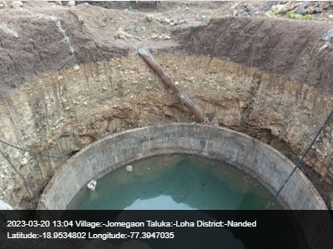
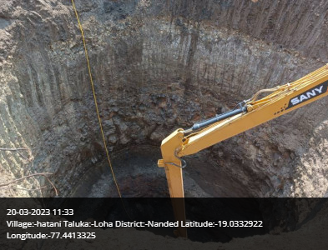
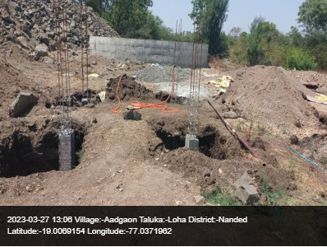
Loha Taluka

Slide 41
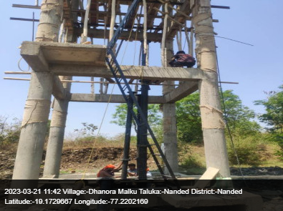
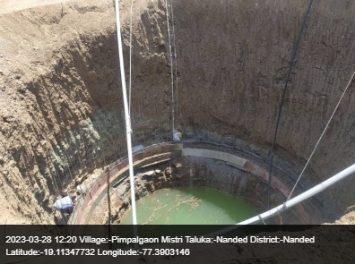
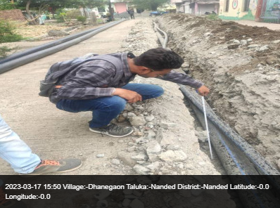
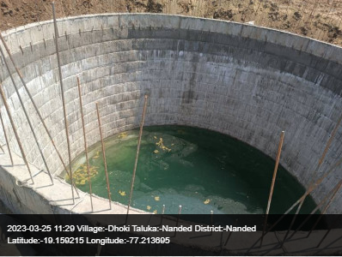
Nanded Taluka

Slide 42
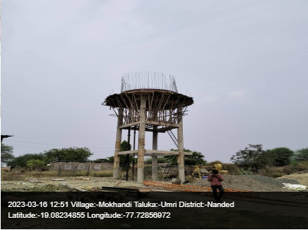
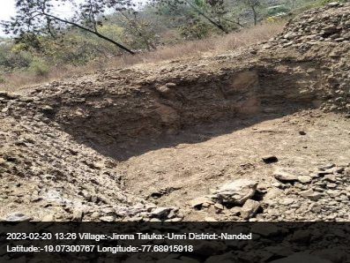
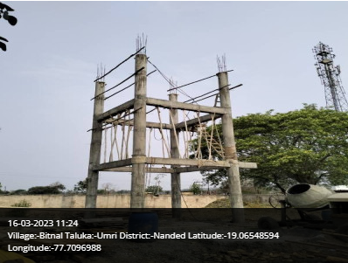
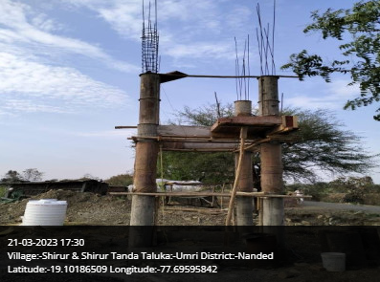
Umri Taluka

Slide 43
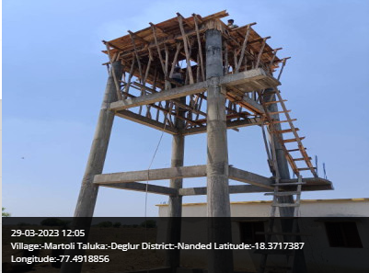
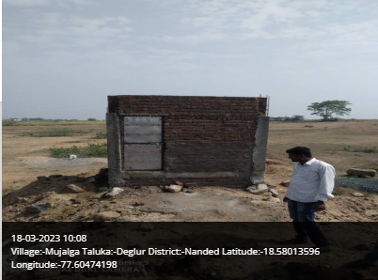
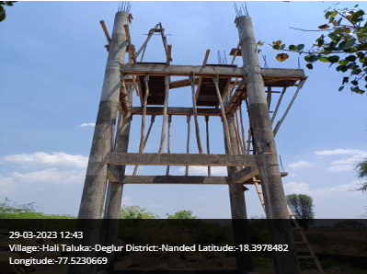
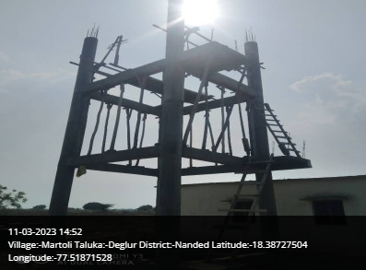
Deglur Taluka

Slide 44
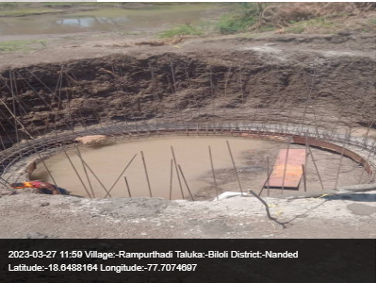
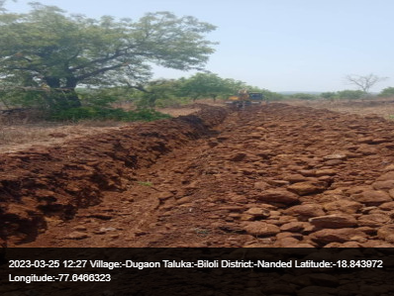
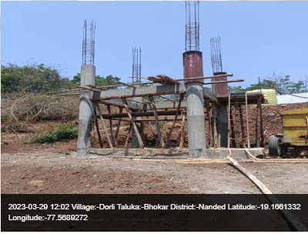
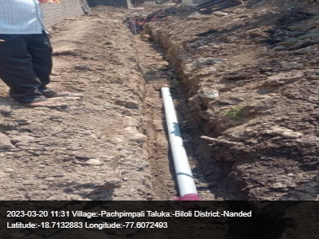
Biloli Taluka

Slide 45

Thank You!

